Slide 1
Careem Captian
Pratik Patel
Azmal Khan

Slide 2
Problem Statement
One of the goals we strive towards at Careem is creating a perfect booking experience for our Customers- extremely reliable ETAS, accurate locations, best Captains and so on. Build a ride dispatching platform that collects location updates from ‘drivers on the move’ to later be used as data to dispatch the best driver to a customer that wants to book a ride. It is up to you to creatively decide the features, capability and complexity of the platform (Eg: Moving cars on the map, multiple bookings per driver etc.)

Slide 3
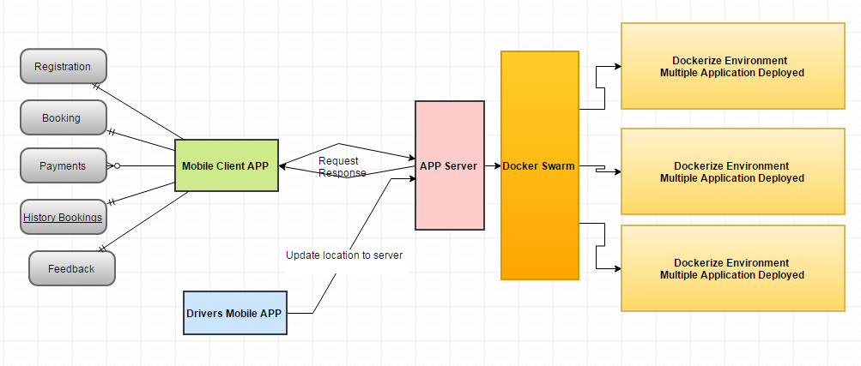
High Level Architecture

Slide 4
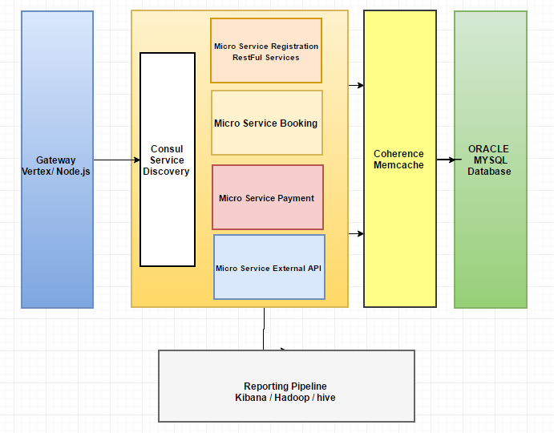
Technology Stack

Slide 5
Best driver selection for ride
Availability
Distance of driver from customer location.
Based on customer feedback of driver.
Custom points for ride time using google map api’s and actual ride for driver’s part rides.

Slide 6
Thank you

